Slide 1
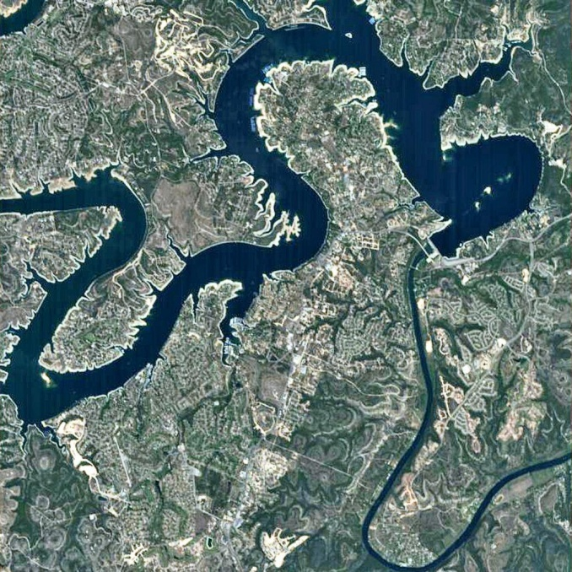
Standards: How do we use the data and what data do we need to establish future criteria
      Laurie A. Eng Fisher
      Water Quality Standards Group
      Monitoring and Assessment Section
      Tel. 512/239-1713
      Laurie.eng@tceq.texas.gov
Notes:
1
Introductions and what I will be talking about today
- Issues in Nutrient Criteria Development
What types of data and how it is used by standards (traditional perspective versus emerging methodology)
Data Analysis Considerations for criteria development
General tour of some data examples
Questions

Slide 2
Nutrient Criteria Issues
Lack of clear “use-based” thresholds for uses such as recreation & aesthetics, aquatic life propagation, drinking water sources
Responses to nutrients are highly variable – e.g., effect of TN and TP on chl a
No consensus on how to derive criteria. Initial EPA guidance criteria were problematic
Independent criteria or “weight-of evidence”?
Limitations in using historical monitoring data
High concern about regulatory impacts
Notes:
So what are some of the issues that make nutrient criteria development difficult –
As Jill eluded to:
Lack of clear “use-based” thresholds for uses such as recreation & aesthetics, aquatic life propagation, drinking water sources
Responses to nutrients are highly variable. For example the effect of TN and TP on chl a
No consensus on how to derive criteria. Initial EPA guidance criteria were problematic, and at this point they are unsure of the preferred methodology themselves – focusing on nutrient reduction strategies.
Independent criteria or “weight-of evidence”?
Limitations in using historical monitoring data, which I’ll be discussing more in a bit
And as Raj eluded to:
There is a high concern about regulatory impacts from stakeholders

Slide 3
What Data?
Parameter | AWRL | PQL | LOQ HL
Nitrate mg/L | 0.05 | 0.02 | 0.02
Nitrite mg/L | 0.05 | 0.02 | 0.02
Nitrate plus Nitrite mg/L | 0.05 | 0.04 | 0.04
TKN mg/L | 0.2 | 0.2 | 0.2
Total Phosphorus mg/L | 0.06 | 0.02 | 0.02
Chl a ug/L | 3 | 3 | 2.2
        Total Nitrogen - conundrum
        Other nitrogen parameters needed
        Detection limit < 0.24
        Also Need…..
        Transparency, 24 Hr DO, Flow, Fish & Benthics, periphyton (benthic chl a ), etc.,
Notes:
3
What data does standards look at when working on nutrient criteria.
The table shows Ambient Water Reporting Limits (AWRL), Practical Quantitation Limits (PQL) and Limit of Quantitation (LOQ) for the water quality parameters (Nitrate, Nitrite, Nitrate plus Nitrate, TKN, Total Phosphorus, and Chlorophyll-a)
For the Nitrogen parameters these are not the dissolved methods, even though din is often collected in research stu.dies, there is not enough dissolved data to consider for my purposes and I am not sure about the comparability, etc. , and 0
Additionally (as Jill mentioned) EPA says thou shall have not only TP criteria but also TN criteria, so we have to calculate TN using what we have
current methodology Nitrate plus Nitrite + TKN or Nitrate + Nitrite +TKN
Gets a little complicated because there are two parameters for Nit+Nit, and not all the nitrogen parameters are always collected.
The TN calculation results in a <0.24 reporting limit, or at least that’s how it has been explained to me
Other variables' of interest are transparency, 24 hour DO, flow, Fish and Benthics, Benthic chl-a, periphyton (streams), etc.

Slide 4
How Does TCEQ Use the Data
Look at mean or median or some percentile, examine trends in the data
Examine stressor response or indicator, look at impacted versus unimpacted, and/or historical variability
Traditionally – ½ Censored Value
Notes:
Standards uses the data by:
Looking at mean or median or some percentile, and examine trends in the data, by station, segment or water body grouping
Examine stressor response or indicator, look at impacted versus unimpacted water bodies, and/or examine the historical conditions and account for variability
Traditionally one half of the < value is substituted for values reported as less than in the SWQMIS database, when analyzing and/or summarizing the data. Need to keep in mind that we don’t see all the particulars of each data point, we are usually doing relatively large data downloads
For our discussion….
~ When I say censored value or < value I mean the value that is reported as < the data in SWQMIS
~ Pre 2000/2003 these < values could be the method detection limit or post 2000-2005 it could be the limit of quantitation LOQ which could be at or below the Ambient Water Reporting Limit AWRL (I believe Steve Gibson will be talking about these more later)

Slide 5
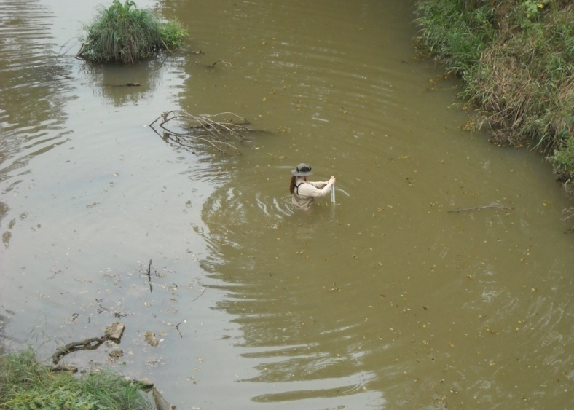
Data Analysis Considerations
Censored Value issues with current data
          Analysis with substitution compromised at anywhere from 10-30%
          Different statistics – survival analysis
Lack of paired data – to calculate TN, and examine relationships
Historical Data –
change in sampling sites,
use old data, don’t use
old data, censor old data,
change in method?
Notes:
5
Here is where we have to start really thinking about the data and how to use it, and for that matter what it means…..
Censored Value or < values can cause issues data analysis
- Analysis with substitution compromised at anywhere from 10-30%
And require different statistical analysis such as survival analysis, to avoid error produced from substitutions. The major draw back to this is it is a little more complicated and harder to explain
Currently we are investigating these methodologies to better deal with our existing dataset
Other Major Considerations when looking at the data include:
Lack of paired data to examine relationships, as I mentioned we need to calculate TN, or examine response variables such as chl-a, transparency, or periphyton
There have been changes in sampling sites, collection methodology, reporting limits, etc.
when it comes to Historical Data many questions come up that will need to be answered and discussed before data analysis
Do we use old data or new data? Do we censor old data to reflect current reporting methodology?
Do we only use stations currently sampled? Do we combine adjacent stations, that are very similar?
Are changes in methods comparable, such as spectrophotometric versus fluorometric chlorophyll a methods or the nitrate plus nitrite methods? Is there publications that support the comparability or side by side studies in the lab? Are they accessible to data users?
Crazy data points - - there are some odd data occasionally, really high values or crazy low values – could be error or outlier or something?????
These are all things to consider when looking at the data and trying to figure out what is appropriate for standards development, for that matter it is probably things that should be considered whenever working with sampling or analysis of a water body.

Slide 6
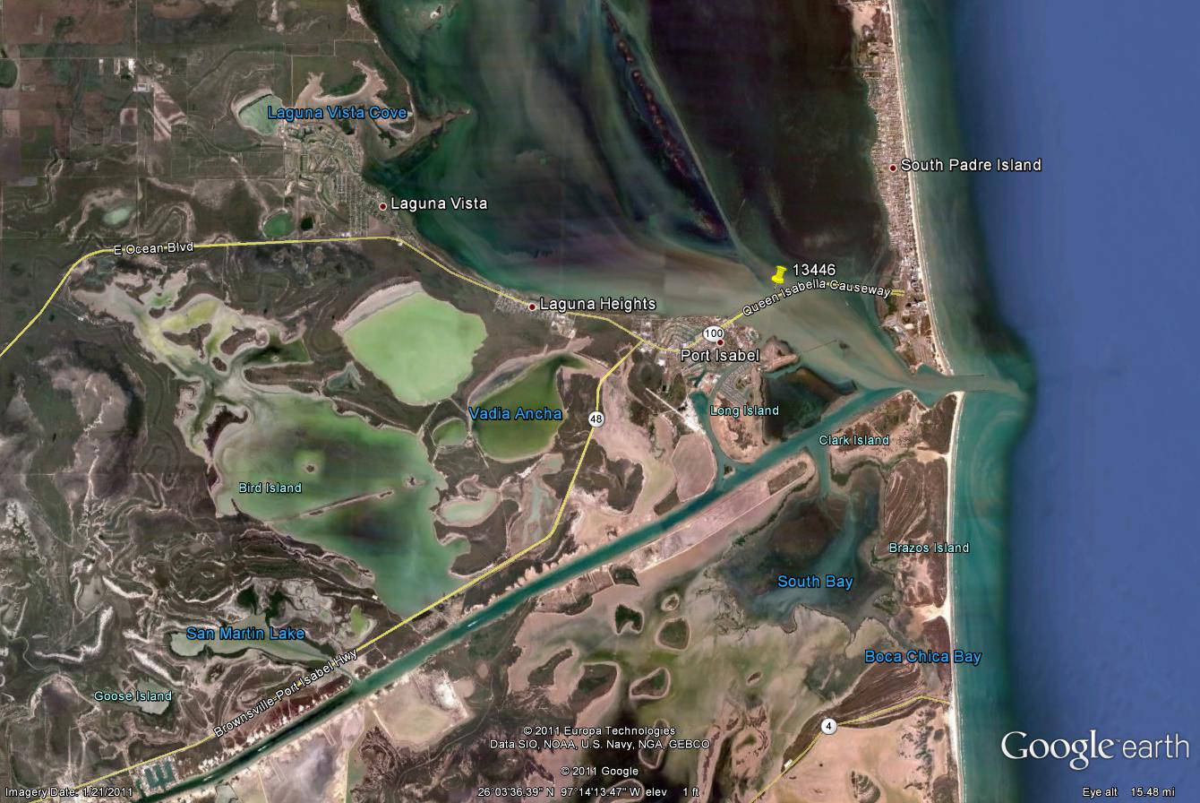
Laguna Madre Map: Segment 2491
Notes:
Laguna Madre Segment 2491 Station 13446 – Historical and currently sampled station

Slide 7
2491- Laguna Madre, station 13446
 | Chl-a | Chl-a^{½} | Chl-a S | Chl-a S^{1/2} | Chl-a F | Chl-a F^{1/2}
N | 137 | 137 | 122 | 122 | 15 | 15
Mean | 4.8 | 3.7 | 4.8 | 3.6 | 4.9 | 4.1
Median | 4.0 | 3.1 | 4.0 | 3.1 | 3.0 | 1.5
75 th | 7.5 | 5.0 | 9.0 | 5.0 | 5.3 | 5.3
Notes:
7
(going to look at graphs now, for the upcoming graphs, sampling dates will be along the X axis, the value for the parameters of interest will be long the Y axis, and parameters will be color and shape coded)
First Lets look at Chlorophyll a data for this station
Good historical coverage
But consider: This graph is showing the < values at the value, so <10 is shown as 10
There was a change in method
There were changes in reporting limits over time, with the AWRL of 10ug/L for about 4 or so years
When looking at these data, you get the idea that using substitution would, and could have affect on your analysis
Also looking at upper percentile or distribution of newer data with lower detection limits is picks up more of the data
SAMPLE SIZE, MEAN, MEDIAN, 75th

Slide 8
Historic nitrogen levels
 | NO3 | NO3 ^{1/2} | NO2 | NO2 ^{½} | Nit+Nit | Nit+Nit ^{1/2} | NO2+3 | NO2+3 ^{1/2} | TKN | TKN^{1/2} | TN | TN^{1/2}
N | 87 | 87 | 29 | 29 | 49 | 49 | 36 | 36 | 74 | 74 | 70 | 70
Mean | 0.117 | 0.072 | 0.263 | 0.135 | 0.955 | 0.948 | 0.214 | 0.147 | 0.306 | 0.302 | 0.631 | 0.505
Median | 0.030 | 0.020 | 0.020 | 0.015 | 0.040 | 0.020 | 0.040 | 0.020 | 0.290 | 0.290 | 0.340 | 0.340
75th | 0.031 | 0.031 | 0.375 | 0.188 | 0.040 | 0.030 | 0.225 | 0.113 | 0.385 | 0.385 | 0.585 | 0.570
Notes:
8
Here is a graph of the nitrogen parameters historically (Note I cut off some of the TKN values above 0.5 for this presentation, they are some up there, after around 1993)
We notice we have had changes in methods or parameters collected
There has been some odd reporting limits or <, as I mentioned MDLs, maybe some dilution driven reporting limits?
A change in Nit+Nit method or at least what was reported.
Remember I mentioned that there were some suspect values – these reported Nitrite values are high
if I calculated TN I’d have a lot of < 0.24s
TKN is picking up most of the time, however if I applied the <0.2 value which is the AWRL and LOQ of most labs we would have some non detects

Slide 9
Historic Laguna Madre phosphorus levels
 | OP>15 | OP>15^{1/2} | OP<15 | OP<15^{1/2} | TP | TP^{1/2}
N | 115 | 115 | 19 | 19 | 150 | 150
Mean | 0.141 | 0.078 | 0.040 | 0.021 | 0.052 | 0.046
Median | 0.030 | 0.020 | 0.040 | 0.020 | 0.050 | 0.036
75 | 0.048 | 0.048 | 0.040 | 0.020 | 0.060 | 0.060
Notes:
9
Here is a graph of the phosphorus collected at the same Laguna Madre station
Again there are the reporting limits that come into effect around 2000
Affects the descriptive statistics, but not the 75th pecentile

Slide 10
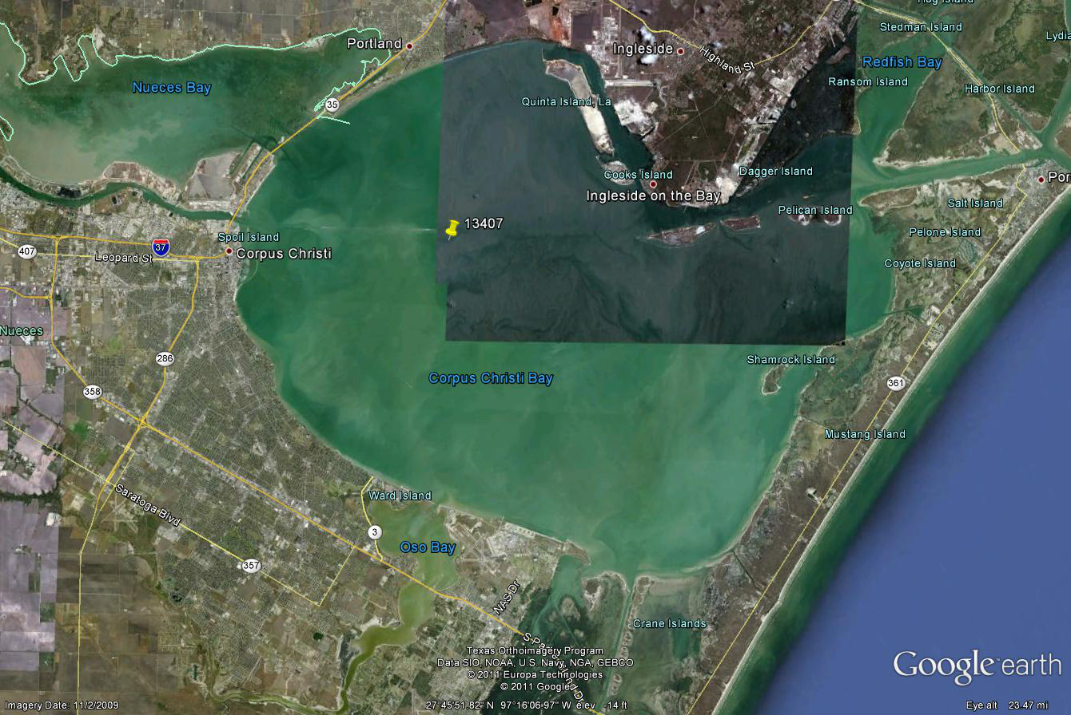
Corpus Christi Bay segment 2481
Notes:
Corpus Christi Bay Segment 2481 station 13407

Slide 11
2481- Corpus Christi, station 13407
Notes:
11
Chlorophyll- a
Again, if I was to look at the historical descriptive they would be different between method and between method of –substitution
And if you imagine looking at trend over time, dependent on substitution method there may appear to be a trend where there is not

Slide 12
2481- Corpus Christi historic nitrogen
Notes:
Again, now with nitrogen different methods when separate would show completely different stories.

Slide 13
2481- Corpus Christi historic phosphorous
Notes:
Lastly with phosphorous, different methods when separate would show completely different stories.

Slide 14
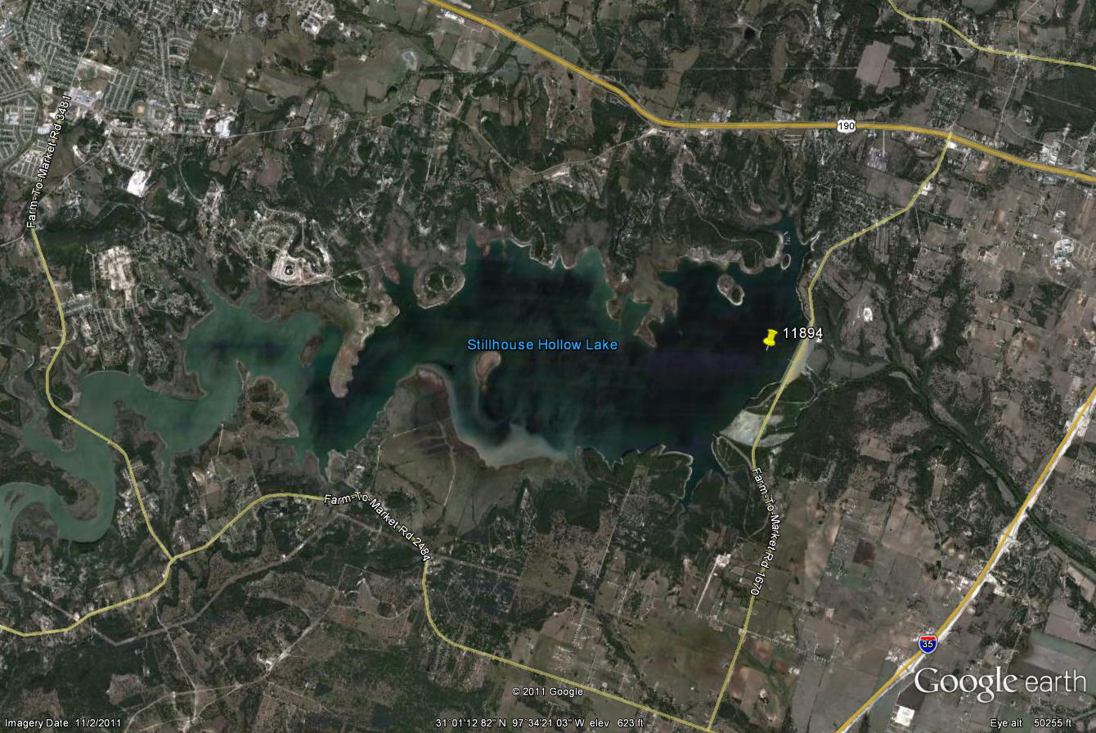
Map of Stillhouse Hollow Lake
Notes:
Lastly – a Trend Example
Stillhouse Hollow Lake Near Killeen/Belton, Segment 1216, station 11894 near the dam

Slide 15
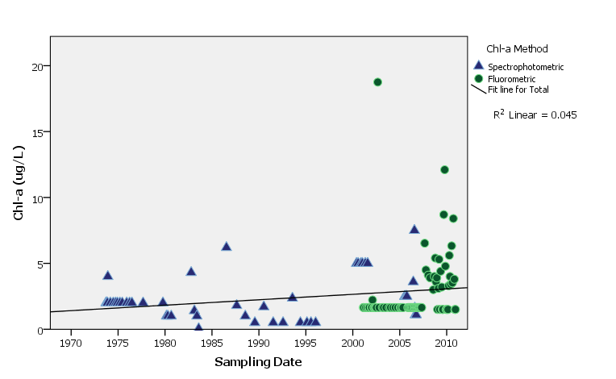
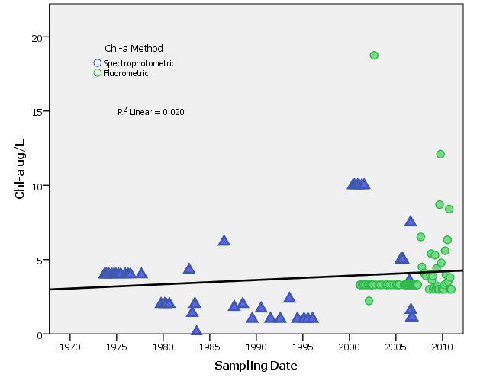
Stillhouse Hollow Lake Chlorophyll a
Notes:
Stillhouse Hollow Lake Chlorophyll a
- When using one half reported < value
~ Chl- a combine – significant upward
~ Chl –a Fluorometric – significant upward
~ Chl – a Spectro significant upward
- No significant trends when using whole < value substitutions
- Chl- a Criteria defaults to 5 ug/L calculated out at 2.07 ug/L – traditional ½ of reported value was used in the calculation of the criteria

Slide 16
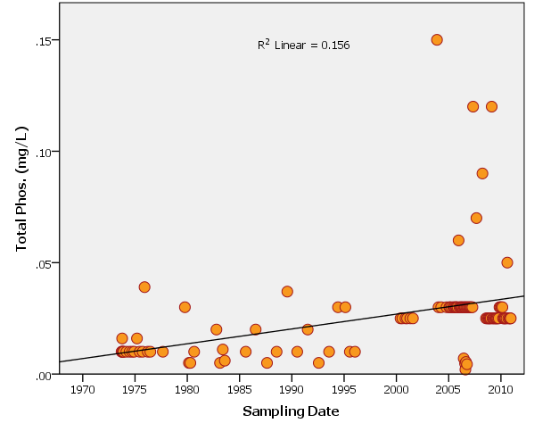
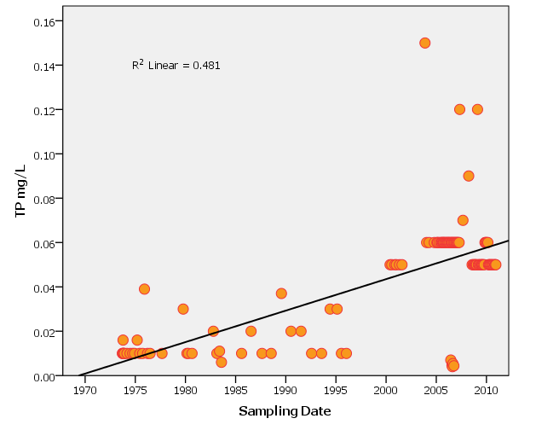
Stillhouse hollow- total phosphorous
Notes:
Stillhouse Hollow – Total Phosphorus Example
- Significant upward Half Value Substitution – Shown by many data points around 0.03 and 0.025
- Significant upward trend when using Whole Value of < Subsituted. Note it is stronger using whole.
- Demonstrates the affect of historical reporting (pre 2000), highly censored data set

Slide 17

Take Home
What will help data users down the road
      Lower reporting limits in those waters where appropriate
      Use of lab methods/tests that work
      Collection of paired parameters, i.e. N + P + Transparency + 24hr Do, etc.
      Possibly focus on less sites with more coverage
Notes:
17
What will help data users down the road, that’s why we are here today is for 5 or 10 years out
When possible Lower reporting limits in those waters where appropriate
Use of lab methods/tests that work and make sense for characterizing a waterbody
Collection of paired parameters, i.e. N + P + Transparency + 24hr Do, etc.
Possibly focus on fewer sites with greater parameter coverage

