Slide 1
Phase II Small Municipal Separate Storm Sewer System (MS4) General Permit No. TXR040000 2024 Renewal Stakeholder Meeting
Water Quality Division - Stormwater Team
September 27, 2022

Slide 2
Agenda
Welcome and Introduction Rebecca L. Villalba
Meeting Overview
Goals and Objectives Rebecca
Overview of the Renewal Timeline Rebecca
Brief Overview of Existing TXR040000 Macayla Coleman
Summary of Proposed Changes to TXR040000 Macayla & Rebecca
Moving to Comprehensive Permit
Revisions for Electronic Applications and Reports
Other Modifications and Clarifications
Stakeholder Discussion
Stakeholders Provide Input on the Proposed Changes and Additional Comments on the Existing Permit
Summary and Adjournment Rebecca

Slide 3
Housekeeping Items
Please sign in so we can record your attendance at the meeting
In person attendees sign in is available at the entrance
Webcast attendees may email their name and organization to Outreach@TCEQ.Texas.gov to record their attendance
Please hold any questions until the Stakeholder Discussion portion of the meeting
Participants joining via Webcast can submit questions during the meeting to Outreach@TCEQ.Texas.gov
The meeting handout and presentation slides are available at the Stormwater Stakeholders Group webpage
A recording of this meeting will be available afterward on the TCEQ YouTube channel

Slide 4
Presentation Outline
MS4 Renewal Timeline
Brief Overview of Existing Permit
Proposed Changes
Stakeholder Discussion
Goals and Objectives

Slide 5
Goals and Objectives
Facilitate stakeholder involvement in the 2024 Phase II MS4 General Permit renewal process
Review existing permit requirements
Explain preliminary proposed changes to the permit for the 2024 renewal
Demonstrate benefits to MS4s and TCEQ
Gather stakeholder input and answer questions
This Photo by Unknown Author is licensed under CC BY-NC

Slide 6
Presentation Outline
MS4 Renewal Timeline
Brief Overview of Existing Permit
Proposed Changes
Stakeholder Discussion
Goals and Objectives

Slide 7
Tentative TXR040000 Renewal Timeline
Stakeholder Meeting & Comment Period
September-November 2022
Prepare Draft Permit
December 2022 -March 2023
EPA Review (90 days)
Summer 2023
-Public Notice in Texas Register & newspaper(s)
September 2022
May 2022
Renewal Process Started
December 2023/ January 2024
Commissioner's Agenda for Adoption
-Public Comment Period (30 days)
-Public Meeting
May-September 2022
Research and Meetings with EPA
*Tentative Dates, additional information located at https://www.tceq.texas.gov/permitting/stormwater/ms4

Slide 8
Presentation Outline
MS4 Renewal Timeline
Brief Overview of Existing Permit
Proposed Changes
Stakeholder Discussion
Goals and Objectives

Slide 9
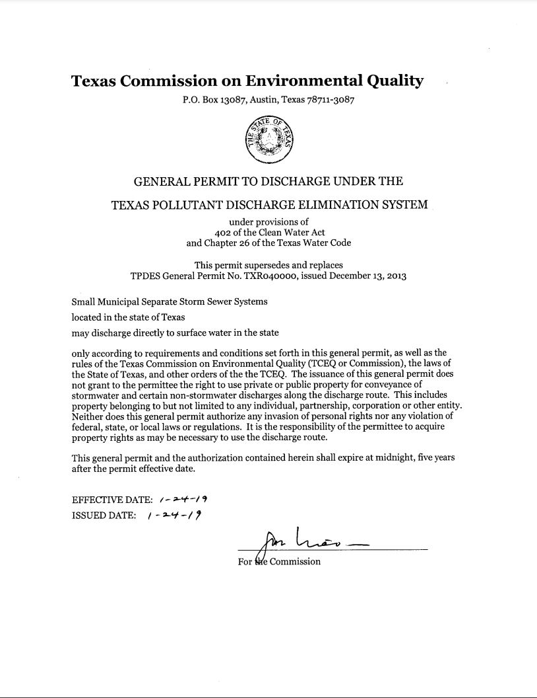
Current Phase II MS4 General Permit
TXR040000, also referred to as the Small MS4 General Permit
Effective January 24, 2019
Expires January 24, 2024
Authorizes stormwater and certain non-stormwater discharges from small MS4s to surface water in the state

Slide 10
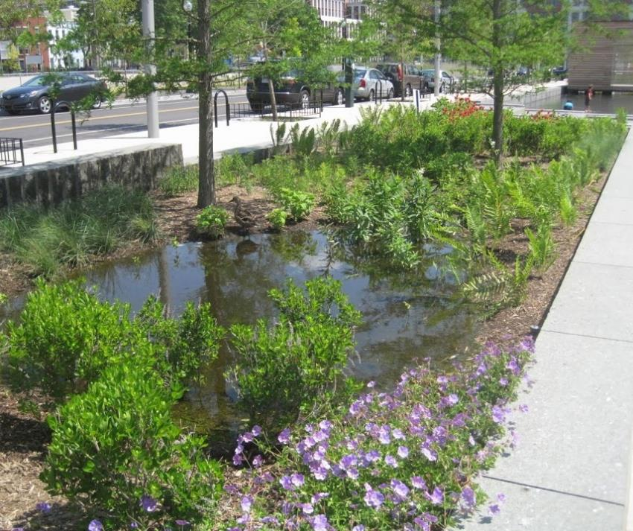
What is a Municipal Separate Storm Sewer System (MS4)?
Publicly-owned or operated stormwater drainage system
Designed to collect or convey stormwater
Includes storm drains, ditches, curbs, gutters, municipal streets, roads with drainage
This Photo by Unknown Author is licensed under CC BY-SA

Slide 11
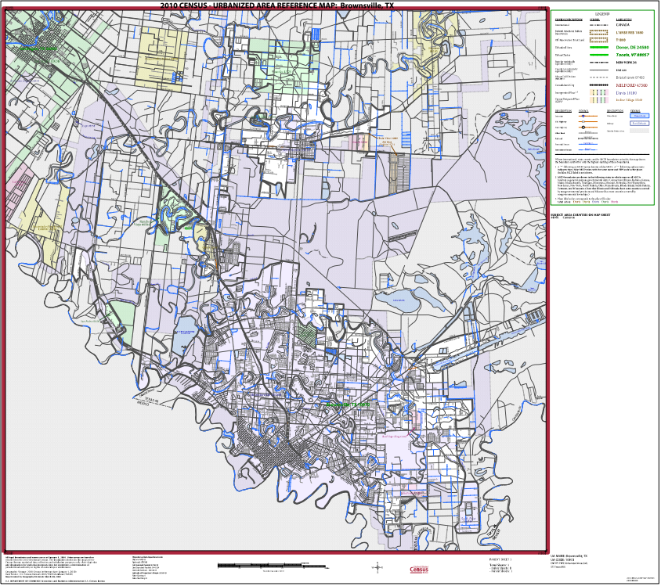
Urbanized Areas
An Urbanized Area (UA)
is a central place (or places) and the adjacent densely settled surrounding territory,
has a minimum population of 50,000 people, and
has a minimum average density of 1,000 people/square mile.
Small MS4s are in UAs
The U.S. Census Bureau developed UA maps that are used as the basis for small MS4 permit requirements.
Brownsville, TX 10972
U.S. Census (2010). 2010 Census – Urbanized Area Reference Map: Brownsville, TX. https://www2.census.gov/geo/maps/dc10map/UAUC_RefMap/ua/ua10972_brownsville_tx/DC10UA10972.pdf

Slide 12
Tiered Permitting Approach
Level 1
Level 2
10,000 to 40,000*
Level 3
40,000 to 100,000*
Additional Requirements in MCMs 2, 3, and 5
Level 4
Includes non-traditional MS4s
More than 100,000*
Up to 10,000*
Additional Requirements in MCMs 2, 3, 4, and 5
Required to implement MCM 6
Additional Requirement in MCM 2
* Population in UA based on 2010 U.S. Census
- Waiver option available for population less than 1,000

Slide 13
Current TXR040000 Authorizations

Slide 14
Federal MS4 General Permit Remand Rule
Rule published in Federal Register - Dec. 9, 2016
Effective date - Jan. 9, 2017
Includes options for states to administer their Phase II MS4 program, 40 CFR §122.28(d)
Option 1: Comprehensive General Permit Approach
The general permit includes all “clear, specific, and measurable” requirements necessary to meet the MS4 permit standard “to reduce pollutants to the maximum extent practicable” (MEP)
No additional requirements are established after permit issuance
Option 2: Two-Step General Permit (Procedural Approach)
First Step: The general permit includes “clear, specific, and measurable” requirements for some program areas for all MS4s
Second Step: The state establishes additional requirements and BMPs for individual MS4s. This is in the stormwater management programs (SWMPs).

Slide 15
Texas Currently Implements Option 2
Two-Step Permitting Process:
TCEQ issues statewide “base” general permit
MS4s write their own SWMP – with enforceable permit requirements
TCEQ and EPA review each MS4’s NOI/SWMP
MS4s publish notice of NOI/SWMP in newspaper
30-day public comment period and opportunity for public meeting
TCEQ responds to public comments and/or holds public meeting
TCEQ approves NOI/SWMP to authorize the MS4 under the general permit
MS4s implement public notice process for NOCs that are not considered minor modifications
MS4 publishes notice of the NOC on its website, or
TCEQ posts notice of NOC on its website if the MS4 does not have a website

Slide 16
Overview of TXR040000 Requirements for Phase II MS4s
Develop and implement a SWMP that includes:
Six minimum control measures (MCMs), with an optional seventh MCM
A schedule for implementation expressed as months and years over the five-year general permit term,
Full implementation at the end of the five-year general permit term, and
Additional requirements for discharges into impaired waterbodies (as applicable)
Submit annual reports
Public Education, Outreach, and Involvement
Illicit Discharge Detection and Elimination
Construction Site Stormwater Runoff Control
Post-Construction Stormwater Management in New Development and Redevelopment
Pollution Prevention and Good Housekeeping Operations
Industrial Stormwater Sources
Optional: Authorization for Construction Activities where the Small MS4 is the Site Operator

Slide 17
Best Management Practices (BMPs) and Measurable Goals
MCMs are addressed in SWMP through BMPs that include measurable goals
Measurable Goals – clear, specific, and measurable
Tracking implementation over time
Measuring progress in implementing BMPs
Tracking total number of BMPs implemented
Tracking program effectiveness in reducing pollutants to the MEP
Tracking environmental improvement
This Photo by Unknown Author is licensed under CC BY-NC

Slide 18
Sharing SWMP Responsibilities: Coalitions
Multiple MS4s that share efforts in meeting any or all SWMP requirements
Shared SWMPs must include
the names and authorization numbers (TXR04####) of each coalition member, and
clear descriptions of each members’ responsibilities for specific MCMs or other SWMP elements.
Tenney, Fred, and Kevin Hilbert. 2009. Large Letter Postcards: The Definitive Guide 1930s to 1950s. Atglen, Pennsylvania: Schiffer Publishing, Ltd. 176 p.

Slide 19
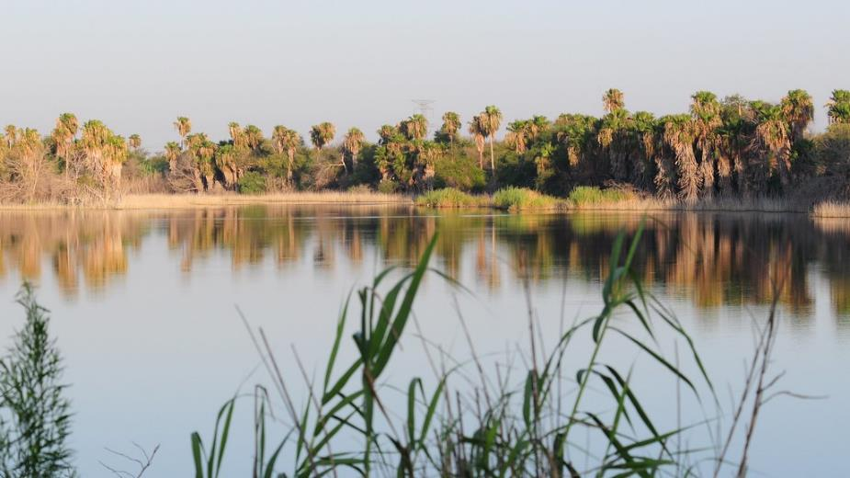
Discharges to Impaired Waterbodies
SWMPs must address impaired waterbody requirements
Impaired: Identified as not meeting Texas Surface Water Quality Standards on the latest TCEQ & EPA-approved Texas Integrated Report Index of Water Quality Impairment
Impaired with and without Total Maximum Daily Loads (TMDLs)
MS4s must annually evaluate status of receiving waterbodies
Note in annual report
This Photo by Unknown Author is licensed under CC BY
Image of the Bentsen-Rio Grande Valley State Park

Slide 20
Presentation Outline
MS4 Renewal Timeline
Brief Overview of Existing Permit
Proposed Changes
Stakeholder Discussion
Goals and Objectives

Slide 21
How Are Permit Renewal Changes Determined?
Draft Permit
Stakeholder Input
TCEQ Program Area Input
Management Input
New and Updated Rules
EPA Approved MS4 General Permits

Slide 22
Proposed Changes for 2024 MS4 General Permit Renewal Move from Two-Step to Comprehensive Permit Type
Revise general permit to meet the Comprehensive standard under the federal 2017 MS4 General Permit Remand Rule
Prescribe specific requirements/BMPs for each MS4 to implement in their SWMP
Remain flexible for MS4s to address local concerns
Remove public notice requirements for NOIs and NOCs
Reduce costs of up to $5,000 for MS4s
This Photo by Unknown Author is licensed under CC BY

Slide 23
Proposed Changes for 2024 MS4 General Permit Renewal Move from Two-Step to Comprehensive Permit Type
Base general permit includes all the clear, specific, and measurable requirements for MS4s
List of target audiences and pollutants
Table of Activities/BMPs and associated Measurable Goals for each MCM
Specify frequency and minimum to pick from
Based on MS4s in Texas and other EPA approved state permits
Maintain flexibility for MS4s
“Menu” of BMPs for select MCMs
Ability to address local concerns and resources
Requirements and level of effort increase with MS4 Level
Refer to pages 3-16 of handout of preliminary proposed changes

Slide 24
Proposed Changes for 2024 MS4 General Permit Renewal Move from Two-Step to Comprehensive Permit Type
Remove requirement to submit a SWMP with the NOI
Remove TCEQ and EPA NOI/SWMP technical review requirements
Conducting technical reviews are resource intensive
Only require administrative review of NOIs which can be done much more quickly
MS4s will identify in the NOI which BMPs listed in the permit they plan to implement
Create streamlined Annual Reporting based on NOI submittal
Annual report will pull BMP information from the NOI for the MS4s to report

Slide 25
Phase II MS4 General Permit Application Review Process
Administrative Review of Application
Technical Review by Water Quality Standards
Technical Review by Stormwater Team
Technical Review by EPA
Draft Public Notice
MS4 Publishes Notice
Revise Deficiencies as Necessary
30-day Comment Period
TCEQ issues Authorization

Slide 26
Proposed Changes for 2024 MS4 General Permit Renewal Revisions for Electronic Applications and Reports
Electronic applications and reporting required for this general permit by December 2025 by the federal Electronic Reporting Rule (40 CFR Part 127)
TCEQ will use EPA’s electronic application and reporting system for the 2024 general permit renewal
No paper applications or reports under the renewed general permit
TCEQ is scheduled to start setting up the Phase II MS4 permit in EPA’s system next year
Later in the process, beta testing will be available to Texas MS4s
Changes to the general permit are necessary to fit into EPA’s system

Slide 27
Proposed Changes for 2024 MS4 General Permit Renewal Revisions for Electronic Applications and Reports
Split current MCM 1 into MCMs 1 and 2 for consistency with federal rules (40 CFR §122.34(b))
Current General Permit
MCM 1: Public Education, Outreach, and Involvement
Proposed Change
MCM 1: Public Education and Outreach
MCM 2: Public Involvement/Participation
Necessary for consistency across nation and implementation into EPA’s electronic application and reporting system

Slide 28
Proposed Changes for 2024 MS4 General Permit Renewal Revisions for Electronic Applications and Reports
Remaining MCMs become renumbered as follows, for eight total MCMs
Current General Permit
MCM 2: Illicit Discharge Detection and Elimination (IDDE)
Proposed Change
MCM 3: IDDE
MCM 3: Construction Site Stormwater Runoff Control
MCM 4: Post Construction Stormwater Management in New Development and Redevelopment
MCM 5: Pollution Prevention and Good Housekeeping for Municipal Operations
MCM 6: Industrial Stormwater Sources
MCM 7: Authorization for Construction Activities where the Small MS4 is the Site Operator
MCM 4: Construction Site Stormwater Runoff Control
MCM 5: Post Construction Stormwater Management in New Development and Redevelopment
MCM 6: Pollution Prevention and Good Housekeeping for Municipal Operations
MCM 7: Industrial Stormwater Sources
MCM 8: Authorization for Construction Activities where the Small MS4 is the Site Operator

Slide 29
Proposed Changes for 2024 MS4 General Permit Renewal Revisions for Electronic Applications and Reports
Reduce annual report year options to only one schedule for all MS4s
Calendar Year
Necessary to fit into EPA’s electronic reporting system
Current permit allows MS4s to select one of three options:
Permit Year (January 24 – January 23)
Calendar Year (January 1 – December 31)
Fiscal Year (e.g., October 1 – September 30)
Add language to explain how MS4s will address the change during the first reporting year

Slide 30
Proposed Changes for 2024 MS4 General Permit Renewal Revisions for Electronic Applications and Reports
Require Coalitions to identify in the NOI the coalition member responsible for submitting Annual Reports
Allows for shared annual reports to be submitted in the electronic system
One member submits the report information for the entire coalition and signs and certifies that the information is true and accurate
All other members submit a signature and certification that the information is being submitted by the designated member and that it is true and accurate

Slide 31
Proposed Changes for 2024 MS4 General Permit Renewal Other Modifications and Clarifications
Clarify what is considered a shared MS4 program and that shared programs are coalitions
“These MS4 operators may combine or share efforts as a coalition in meeting any or all of the SWMP requirements stated in Part III of this general permit. MS4 operators in a coalition that share SWMP development and implementation responsibilities must meet the following conditions:…”
Clarify required actions when TCEQ lowers a TMDL waste load allocation (WLA) during the permit term
Affected MS4 operators must update their SWMP and submit an NOC

Slide 32
Urbanized Areas and the 2020 Decennial Census
The Decennial Census, starting in 2020 and into the future, will no longer identify “urbanized areas.”
EPA issued interim guidance on this elimination:
EPA is evaluating next steps, including whether revisions to the Phase II MS4 regulations are appropriate
In the meantime, EPA recommends permitting authorities move forward with implementing their permits based on:
The currently regulated small MS4s (based on the 2000 and 2010 Censuses)
Any additional or expanded MS4s that the permitting authority designates based on meeting the criteria to be permitted to protect water quality under 40 CFR § 123.35(b).
Interim Guidance on Census Elimination of “Urbanized Area” Definition
https://www.epa.gov/npdes/interim-guidance-census-elimination-urbanized-area-definition

Slide 33
Proposed Changes for 2024 MS4 General Permit Renewal Other Modifications and Clarifications
Clarify that MS4 levels are determined based on the 2010 UAs and the 2020 Decennial Census population data
“This permit defines MS4 operators by the following categories, or levels, based on the current population served within the 2010 UA. The level of an MS4 is based on the most recent Decennial Census at the time of permit issuance. A national Census held during a permit term will not affect the level of an MS4 until the next permit renewal... For the purpose of this section “serve a population” means the residential population within the regulated portion of the small MS4 based on the 2020 Census, except for non-traditional small MS4s.”
Modify MS4 Level 2 to separate non-traditional MS4s from traditional MS4s:
Level 2a: Operators of traditional MS4s that serve a population of 10,000 to < 40,000
Level 2b: Operators of all non-traditional MS4s

Slide 34
Proposed Changes for 2024 MS4 General Permit Renewal Other Modifications and Clarifications
Modify definition of Waters of the U.S. to reference definition in federal rules
“Waters of the United States or waters of the U.S. means the term as defined in 40 CFR § 122.2”
Clarify that MS4s which failed to apply for permit coverage in the previous permit term are not eligible for the 180-day renewal application grace period
“Operators of small MS4s described in Part II.A.1 that did not submit an application for authorization under the 2019 TPDES General Permit TXR040000 and were required to obtain permit coverage based on the 2000 and 2010 UA maps shall submit an NOI immediately.”

Slide 35
Proposed Changes for 2024 MS4 General Permit Renewal Other Modifications and Clarifications
Add permit language to list the federal rule criteria for designating MS4s
“The criteria that the executive director may consider is as follows:
The location of the discharge with respect to waters of the United States as defined at 40 CFR §122.2.
The size of the discharge;
The quantity and nature of the pollutants discharged to waters of the United States; and
Other relevant factors.”
Miscellaneous and editorial changes
Correct typos, clarify unclear language, etc.

Slide 36
Change Being Considered for the 2024 Renewal
Removal of current MCM 7: Authorization for Construction Activities where the Small MS4 is the Site Operator
Only used by a small number of MS4 Operators
Would like stakeholder input on this potential change

Slide 37
Review Proposed Permit Language for New MCMs 1-3
Handout of Preliminary Proposed Changes: https://www.tceq.texas.gov/permitting/stormwater/stormwater_stakeholders_group.html

Slide 38
Presentation Outline
MS4 Renewal Timeline
Brief Overview of Existing Permit
Proposed Changes
Stakeholder Discussion
Goals and Objectives

Slide 39
Stakeholder Discussion
Reminders:
Wait for the microphone before directing your question or comments
Share airtime so that everyone has an opportunity to speak
Webcast attendees send your questions or comments via e-mail to Outreach@tceq.texas.gov

Slide 40
Stakeholder Discussion
Comments and questions?

Slide 41
Stakeholder Comments and Input
You may submit comments on the existing general permit and preliminary proposed changes
Meeting handout and presentation are available online at: https://www.tceq.texas.gov/permitting/stormwater/stormwater_stakeholders_group.html
Submit comments to SWGP@tceq.texas.gov
Include a subject line of “2024 Phase II MS4 Renewal”
Please submit your written comments by Wednesday, October 12, 2022

Slide 42
Stormwater Team Contacts
Stormwater Team
512-239-4671
SWGP@tceq.texas.gov
Stormwater Processing Center (SWPC)
512-239-3700
SWPermit@tceq.texas.gov
Rebecca L. Villalba- Team Leader
Macayla Coleman
Dante Fekete
Madison Taylor
Leland Moore
Jesse Gress-Alamilla
Monica Alba Garcia
Autumn Thornburg, SWPC
Carol Lee Trucksess, SWPC

