Slide 1
Stormwater TPDES Phase II (Small) Municipal Separate Storm Sewer System (MS4) General Permit (TXR040000)
2024 Renewal Public Meeting
Rebecca L. Villalba and Macayla Coleman
TCEQ Stormwater Team, Water Quality Division
September 18, 2023

Slide 2
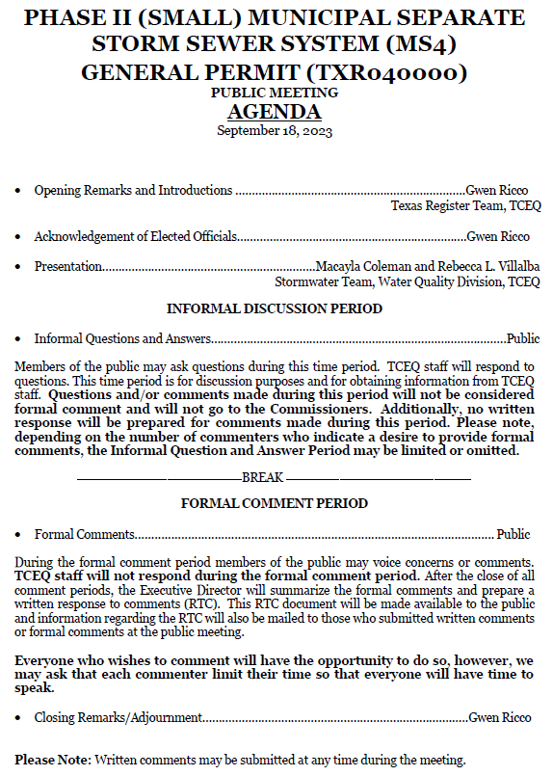
Agenda

Slide 3
Public Meeting Presentation Outline
Basic Overview of the TXR040000 General Permit
2024 Renewal Timeline for TXR040000
Proposed Changes for 2024 Renewal of TXR040000
2020 Census: Urbanized Area vs. Urban Area Terms
Additional Planned Outreach/Resources
Informal Discussion Period
Formal Public Comment Period

Slide 4
TXR040000 General Permit Overview

Slide 5
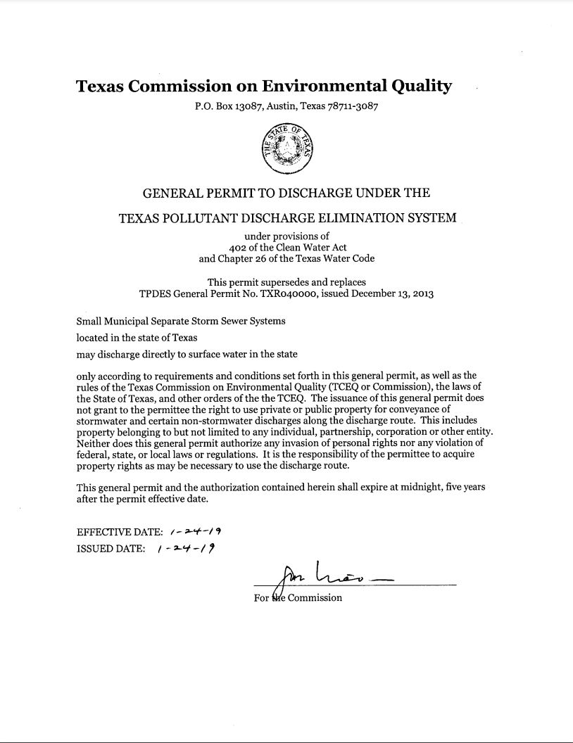
Current Phase II MS4 General Permit
TXR040000, also referred to as the Small MS4 General Permit
Effective January 24, 2019
Expires January 24, 2024
Authorizes stormwater and certain non-stormwater discharges from small MS4s to surface water in the state
Small MS4 - A publicly owned or operated conveyance or system of conveyances designed or used for collecting or conveying stormwater discharges to Waters of the U.S.

Slide 6
Federal MS4 General Permit Remand Rule
Rule published in Federal Register - Dec. 9, 2016
Effective date - Jan. 9, 2017
Includes options for states to administer their Phase II MS4 program, 40 CFR §122.28(d)
Option 1: Comprehensive General Permit Approach
The general permit includes all “clear, specific, and measurable” requirements necessary to meet the MS4 permit standard “to reduce pollutants to the maximum extent practicable” (MEP)
No additional requirements are established after permit issuance
Option 2: Two-Step General Permit (Procedural Approach)
First Step: The general permit includes “clear, specific, and measurable” requirements for some program areas for all MS4s
Second Step: The state establishes additional requirements and BMPs for individual MS4s in the stormwater management programs (SWMPs).

Slide 7
Texas Currently Implements Option 2
Two-Step Permitting Process:
1. TCEQ issues statewide “base” general permit
2. MS4s write their own SWMP – with enforceable permit requirements
TCEQ and EPA review each MS4’s NOI/SWMP
MS4s publish notice of NOI/SWMP in newspaper
30-day public comment period and opportunity for public meeting
TCEQ responds to public comments and/or holds public meeting
TCEQ approves NOI/SWMP to authorize the MS4 under the general permit
MS4s implement public notice process for NOCs that are not considered minor modifications
MS4 publishes notice of the NOC on its website, or
TCEQ posts notice of NOC on its website if the MS4 does not have a website

Slide 8
2024 Renewal Timeline for TXR040000

Slide 9
TXR040000 Renewal Timeline
Stakeholder Meeting & Informal Comment Period
September 2022-February 2023
Prepare Draft Permit
March-June 2023
EPA Review (90 days)
August – September 2023
-Public Notice in Texas Register & Houston Chronicle
September 2022
May 2022
Renewal Process Started
January 2024
Commissioner's Agenda for Adoption
-Public Comment Period (30 days)
-Public Meeting
May-September 2022
Research and Meetings with EPA
September 2023-January 2024
Set up EPA Net-MS4 System for Texas
Fall 2023
-Prepare Response to Comments
-Finalize Permit
*Dates subject to change, additional information located at https://www.tceq.texas.gov/permitting/stormwater/ms4

Slide 10
Proposed Changes for 2024 Renewal of TXR040000

Slide 11
Proposed Changes for 2024 MS4 General Permit Renewal Move from Two-Step to Comprehensive Permit Type
Revise general permit to meet the Comprehensive Permit standard under the federal 2017 MS4 General Permit Remand Rule
Prescribe specific requirements/BMPs for each MS4 to implement in their SWMP
Remain flexible for MS4s to address local concerns
Provide public notice of the defined terms and conditions that will determine compliance for each permittee during the master general permit public notice
Remove public notice requirements for NOIs and NOCs
Reduce costs of up to $5,000 for MS4s
This Photo by Unknown Author is licensed under CC BY

Slide 12
Proposed Changes for 2024 MS4 General Permit Renewal Move from Two-Step to Comprehensive Permit Type
Base or master general permit includes all the “clear, specific, and measurable” requirements for MS4s
List of target audiences and pollutants or sources
Table of Activities/BMPs and associated Measurable Goals for each MCM
Specify frequency and minimum to pick from
Based on MS4s in Texas and other EPA approved state permits
Maintain flexibility for MS4s
“Menu” of BMPs for select MCMs
Ability to address local concerns and resources
Requirements and level of effort increase with MS4 Level

Slide 13
Proposed Changes for 2024 MS4 General Permit Renewal Move from Two-Step to Comprehensive Permit Type
Remove requirement to submit a SWMP with the NOI
Remove TCEQ and EPA NOI/SWMP technical review requirements
Conducting technical reviews are lengthy and resource intensive
Only require administrative review of NOIs which can be done much more quickly
MS4s will identify in the NOI which BMPs listed in the permit they plan to implement
Create streamlined Annual Reporting based on NOI submittal
Annual Report will pull BMP information from the NOI for the MS4s to report

Slide 14
Phase II MS4 General Permit Application Review Process
Administrative Review of Application
Technical Review by Water Quality Standards
Technical Review by Stormwater Team
Technical Review by EPA
Draft Public Notice
MS4 Publishes Notice
Revise Deficiencies as Necessary
30-day Comment Period
TCEQ issues Authorization

Slide 15
Proposed Changes for 2024 MS4 General Permit Renewal Revisions for Electronic Applications and Reports
Electronic applications and reporting required for general permits by December 2025, per federal NPDES Electronic Reporting Rule (40 CFR Part 127)
TCEQ will use EPA’s electronic application and reporting system (Net-MS4) for the 2024 general permit renewal
No paper applications or annual reports under the renewed general permit
Changes to the general permit are necessary to fit into EPA’s system
TCEQ and EPA have started setting up the Texas Phase II MS4 General Permit in Net-MS4
Later in the process, beta testing will be available to Texas MS4s

Slide 16
Proposed Changes for 2024 MS4 General Permit Renewal Revisions for Electronic Applications and Reports
Split current MCM 1 into MCMs 1 and 2 for consistency with federal rules (40 CFR §122.34(b))
Necessary for consistency across nation and implementation into EPA’s electronic application and reporting system
Remaining MCMs become renumbered, for eight total MCMs
Current General Permit
MCM 1: Public Education, Outreach, and Involvement
Proposed Change
MCM 1: Public Education and Outreach
MCM 2: Public Involvement/Participation

Slide 17
Proposed Changes for 2024 MS4 General Permit Renewal Revisions for Electronic Applications and Reports
Reduce annual report year options to only one schedule for all MS4s
Calendar Year
Necessary to fit into EPA’s electronic reporting system
Current permit allows MS4s to select one of three options:
Permit Year (January 24 – January 23)
Calendar Year (January 1 – December 31)
Fiscal Year (e.g., October 1 – September 30)
Added language to explain how MS4s will address the change during the first reporting year
Notes:
For example, the LRGV coalition uses Fiscal year. This will have to move to the Calendar year schedule

Slide 18
Proposed Changes for 2024 MS4 General Permit Renewal Revisions for Electronic Applications and Reports
Require Coalitions to designate in the NOI the coalition member responsible for submitting Annual Reports
Allows for shared annual reports to be submitted in the electronic system
Designated member:
submits the report information for the entire coalition and
signs and certifies that the information is true and accurate
All other members submit a signature and certification that the information is being submitted by the designated member and that it is true and accurate

Slide 19
Proposed Changes for 2024 MS4 General Permit Renewal 2020 Decennial Census
Add to applicability criteria MS4 operators located within the “2020 Urban Areas with a population of 50,000 or more people” to replace the term “urbanized area” throughout the permit
Necessary to comply with the federal NPDES Small MS4 Urbanized Area Clarification rule
Extend coverage to some new MS4 operators
Will not de-regulate any MS4 operators
Once regulated, always regulated
This Photo by Unknown Author is licensed under CC BY-SA-NC

Slide 20
Proposed Changes for 2024 MS4 General Permit Renewal 2020 Decennial Census
Clarify that MS4 levels are determined based on the 2020 Decennial Census urban areas and population data
“This general permit defines small MS4 operators by the following categories, or levels, based on the population served by the MS4 within the 2020 urban area with a population of at least 50,000 people. The level of an MS4 is based on population in the most recent Decennial Census at the time of permit issuance. A national Census held during a permit term will not affect the level of an MS4 until the next permit renewal. For the purpose of this section, “serve a population” means the residential population within the regulated portion of the small MS4 based on the population data from the 2020 Decennial Census, except for non-traditional small MS4s listed in Level 2b below.”

Slide 21
Proposed Changes for 2024 MS4 General Permit Renewal Other Modifications and Clarifications
Clarify what is considered a shared MS4 program and that shared programs are coalitions
“Multiple small MS4s that are physically interconnected, located in the same urban area with a population of at least 50,000 people, or are located in the same watershed may combine or share efforts as a coalition in meeting one or more of the BMP requirements described in the general permit.”
Clarify required actions when TCEQ lowers a TMDL waste load allocation (WLA) during the permit term
Affected MS4 operators must update their SWMP and submit an NOC

Slide 22
Proposed Changes for 2024 MS4 General Permit Renewal Other Modifications and Clarifications
Modify MS4 Level 2 to separate non-traditional MS4s from traditional MS4s:
Level 2a: Operators of traditional MS4s that serve a population of 10,000 to < 40,000
Level 2b: Operators of all non-traditional MS4s
Clarify that MS4s which failed to apply for permit coverage in the previous permit term are not eligible for the 180-day renewal application grace period
“Operators of small MS4s described in Part II.A.1 that did not submit an application for authorization under the 2019 TPDES General Permit TXR040000 and were required to obtain permit coverage based on the 2000 and 2010 urban areas with a population of at least 50,000 people shall submit an NOI immediately.”
Miscellaneous and editorial changes
Reorganizing similar information under the same sections
Correct typos, clarify unclear language, etc.

Slide 23
Proposed Changes for 2024 MS4 General Permit Renewal Optional MCM for Municipal Construction Activities
Add requirement to MCM 8 for operators to
Conduct an observation and evaluation of dewatering controls on the days where dewatering discharges occur
Consistent with the TPDES Construction General Permit (TXR150000), issued on March 5, 2023
Submit Delegation of Signatory forms electronically
Electronic submittal must be done using TCEQ’s online State of Texas Environmental Electronic Reporting System (STEERS)
Required for compliance with federal NPDES Electronic Reporting Rule
For a complete list of changes, see pages 24-27 of the proposed Fact Sheet

Slide 24
Example Proposed BMPs and Measurable Goals Table MCM 4: Construction Site Stormwater Runoff Control
Activity/BMP | Measurable Goals
Develop and maintain an ordinance or other regulatory mechanism as described in Part IV.D.4.(a). | Review and update the ordinance or other regulatory mechanism at least one time during the permit term to address changes and make improvements to the ordinance where applicable.
Conduct construction site inspections as described in Part IV.D.4.(b)(4). | Conduct inspections at 80% of active construction sites annually according to the established procedures (or some Level 2b small MS4s must notify the appropriate agency with the authority to act). Each year, conduct follow up inspections in 100% of cases where necessary as described in the established procedures (except for some Level 2b small MS4s without the appropriate authority to act).
Develop, implement, and maintain procedures for receipt and consideration of information submitted by the public as described in Part IV.D.4.(b)(5). | Review and update procedures for the receipt and consideration of information submitted by the public at least one time annually to address changes and make improvements to the established procedures where applicable. Maintain one webpage, hotline, or similar method for receipt of information submitted by the public throughout the permit term.

Slide 25
New or Renewal Applications and Deadline
Deadline: electronic applications will be due in NeT-MS4 180 days from permit issuance.
New and existing small MS4 operators will need to develop or update their SWMP and submit an application to TCEQ for permit coverage within the renewal period.
Necessary updates to existing SWMPs may include:
reorganizing to separate existing MCM 1 into MCMs 1 and 2 as defined in the draft general permit,
updating activities/BMPs and measurable goals, as appropriate for consistency with the draft comprehensive general permit, and
Including new regulated MS4 areas based on the 2020 Decennial Census.

Slide 26
2020 Census: Urbanized Area vs. Urban Area Terms

Slide 27
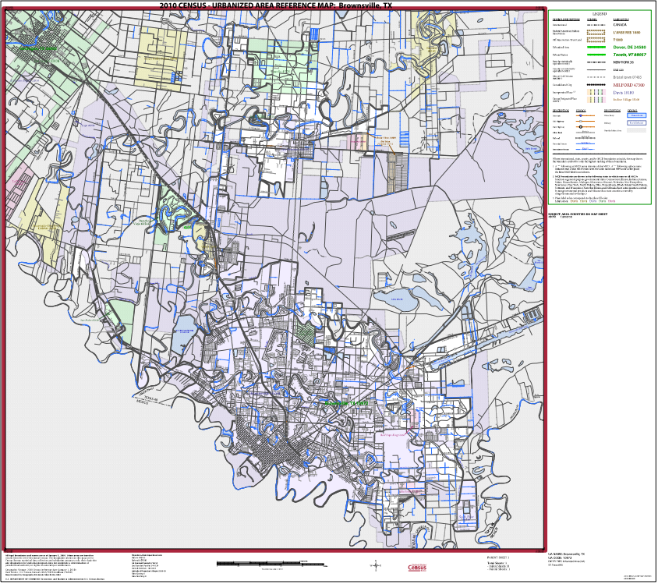
2000 and 2010 Decennial Census
“To qualify as an urban area, the territory identified according to criteria must encompass at least 2,500 people, at least 1,500 of which reside outside institutional group quarters. “
The Census Bureau identified two types of urban areas:
“Urbanized Areas (UAs)” of 50,000 or more people;
“Urban Clusters (UCs)” of at least 2,500 and less than 50,000 people.
U.S. Census (2010). 2010 Census – Urbanized Area Reference Map: Brownsville, TX. https://www2.census.gov/geo/maps/dc10map/UAUC_RefMap/ua/ua10972_brownsville_tx/DC10UA10972.pdf

Slide 28
2020 Decennial Census
No longer defining or identifying “urbanized areas”
The Census Bureau identifies only “urban areas” with no subdivisions for population size
The Census Bureau has published the following resources:
Lists of urban areas across the nation with populations for those areas
Shape files of the urban areas across the nation for mapping purposes
https://www.census.gov/programs-surveys/geography/guidance/geo-areas/urban-rural.html
Interactive web map with the 2020 urban areas - TIGERweb
https://tigerweb.geo.census.gov/tigerweb/
The Census will not publish PDF maps of each area like in the past

Slide 29
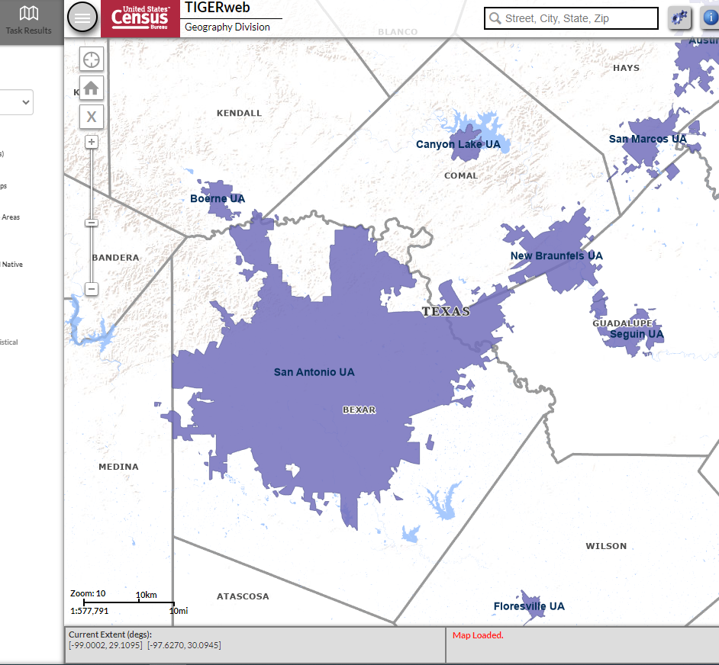
2020 Decennial Census Example using Census Bureau Resources
Urban Area Name | Urban Area Population
San Antonio | 1,992,689
New Braunfels | 100,736
Boerne | 18,320
San Marcos | 70,801
Floresville | 6,313
*“Urban Area with a population of 50,000 or more people”, refers to the population of the urban area and not the individual municipalities within the urban area

Slide 30
Additional Planned Outreach/Resources

Slide 31
Resources
The 2024 proposed general permit and fact sheet located at: https://www.tceq.texas.gov/permitting/stormwater/ms4/WQ_ms4_small_TXRO4.html
New SWMP template
Will be available after the general permit renewal
Final NPDES Small MS4 Urbanized Area Clarification Rule https://www.govinfo.gov/content/pkg/FR-2023-06-12/pdf/2023-12494.pdf
2020 Census and Urban Areas, new TCEQ webpage: https://www.tceq.texas.gov/permitting/stormwater/ms4/urbanareas

Slide 32
Outreach
Currently identifying newly regulated small MS4 operators
Will send notification letters to each
Renewal reminder postcards will be sent out to existing small MS4 operators
Workshops:
To assist new and existing small MS4 operators with understanding the renewal general permit and preparing an application
Virtual or hybrid workshop
Will be recorded and saved on the TCEQ webpages for viewing
In-person workshop
Exploring holding at least one workshop in the Houston or Dallas area
Will be held early in 2024 during the renewal period

Slide 33
Public Comment Period
Submittal of Formal Comments
Comments can be submitted until September 25, 2023:
Office of the Chief Clerk, MC 105
TCEQ
P.O. Box 13087
Austin, TX 78711-3087
or electronically at https://www14.tceq.texas.gov/epic/eComment/

Slide 34
Stormwater Team Contacts
Stormwater Team
512-239-4671
SWGP@tceq.texas.gov
Stormwater Processing Center (SWPC)
512-239-3700
SWPermit@tceq.texas.gov
Rebecca L. Villalba- Team Leader
Macayla Coleman
Dante Fekete
Hannah Cobos
Leland Moore
Jesse Gress-Alamilla
Monica Alba Garcia
Jeneane Toliver, SWPC
Carol Lee Trucksess, SWPC
Mary Huseman, SWPC

Slide 35
Informal Discussion Period
Questions and Answers

Slide 36
Formal Comment Period
Note: comments will not be responded to during the meeting; responses will be provided in the formal Executive Director’s Response to Comments document. These responses will be made available at the time of permit issuance.

